Slide 1


CHEM 105
Sections 31-49
“Choose kindness and compassion over criticism and contention.”
“To speed up God’s work and influence in our lives, we may paradoxically need to slow down. Being always in motion may be adding to the commotion in our lives.”
- General Conference Oct 2024
“When you stumble in the race of life, don’t crawl away from the very Physician who is unfailingly there to treat your injuries, lift you to your feet and help you finish the course.”
- Jeffrey R. Holland, BYU devotional 1/18/2022
Dr. Stacey J. Smith
Fall 2024
“We can think of The Church using the analogy of a prescription drug capsule. The Church is the capsule, and the Atonement of Jesus Christ is the medicine delivered inside the capsule.”
- Kevin S. Hamilton, BYU devotional 1/24/2023
You don't need to be perfect to be in this church. You just need to do your best. Which includes repenting and striving to become something more [through] Jesus Christ.
Clark Gilbert, BYU Devotional 2-8-2022
Notes:
“When you are being hammered on the anvil of adversity, when your soul is being refined with severe lessons that perhaps can be learned no other way, don’t cut and run,” he told BYU students. “Don’t jump ship. Don’t shake your fist at your bishop or your mission president or God. Please stay with the only help and strength that can aid you in that painful time.
“When you stumble in the race of life, don’t crawl away from the very Physician who is unfailingly there to treat your injuries, lift you to your feet and help you finish the course.”

Slide 2
Lecture 14:
4.4-4.6
Lewis
Structures
4.1 Chemical Bonds and Greenhouse Gases
4.2 Electronegativity, Unequal Sharing, & Polar Bonds
4.3 Naming Compounds and Writing Formulas
4.4 Lewis Symbols and Lewis Structures
4.5 Resonance
4.6 The Lengths and Strengths of Covalent Bonds
4.7 Formal Charge: Choosing among Lewis Structures
4.8 Exceptions to the Octet Rule
4.9 Vibrating Bonds and the Greenhouse Effect
5.3 Polar Bonds and Polar Molecules
Notes:
Learning Objectives:
Draw Lewis Dot Structures for simple ionic and molecular compounds
Calculate bond order
Relate bond order, bond strength, and bond length
Draw Resonance structures
Assign formal charges & choose best resonance structures
Understand limitations of Lewis dot structures & exceptions to the octet rule

Slide 3
Write the formula for dinitrogen pentoxide.
N₂O₅
What does it look like?
How are the atoms connected?
Is it polar or nonpolar?
Will it dissolve in water?
How can we predict the structure & properties of compounds from their formulas?
Lewis Structures!
Notes:
How can we know this (without Google)?

Slide 4
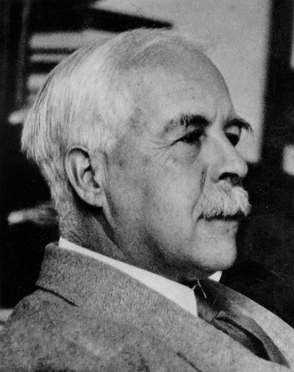
Lewis Structures
Lewis electron dot structures
Systematic way to predict bonding & structure
  Developed before quantum mechanics, but can be rationalized using QM. Is a useful shortcut
Determine the # of valence electrons then:
  Decide which are BONDING ELECTRONS
  Decide which are retained as LONE PAIRS
Later helps us predict molecular shape and properties
G. N. Lewis
1875 – 1946
American chemist
1916 = Lewis dot structures
"A detective with his murder mystery, a chemist seeking the structure of a new compound… Through a series of intuitions, surmises, fancies, they stumble upon the right explanation, and have a knack of seizing it when it once comes within reach." ~ Gilbert N. Lewis
"I have just returned from a short vacation for which the only books I took were a half-dozen detective stories and your 'Chemical Bond'. I found yours the most exciting of the lot.“
G.N. Lewis. In a letter to Linus Pauling. August 25, 1939.
Notes:
Now, Lewis predated quantum mechanics & the idea that electrons move as standing waves, so he still thought of electrons as baseballs.
Or dots, as the case may be
"A detective with his murder mystery, a chemist seeking the structure of a new compound, use little of the formal and logical modes of reasoning. Through a series of intuitions, surmises, fancies, they stumble upon the right explanation, and have a knack of seizing it when it once comes within reach." ~ Gilbert N. Lewis

Slide 5
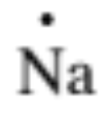
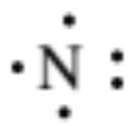
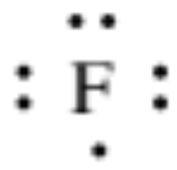
Lewis Symbols
Elements
main group
Element symbol + 1 dot for each valence electron
  Pauli Exclusion Principle: Can put up to 2 dots on each side
  Hund’s Rule: Place dots individually on all 4 sides before pairing
Na = [Ne]3s¹ =
N = [He]2s²2p³ =
F = [He]2s²2p⁵ =
Na
N
F

Slide 6
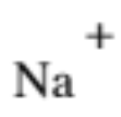
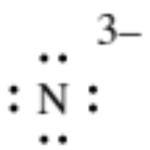
Lewis Symbols ions
main group
Ions: add or remove electrons to achieve 8 valence e- in the ion
Write the charge of the species
Na = [Ne]3s¹ →
N = [He]2s²2p³ →
F = [He]2s²2p⁵ →
Na⁺ = [Ne]
N³⁻ = [He]2s²2p⁶
F⁻ = [He]2s²2p⁶
F
Notes:
Hhmmm… notice a pattern here?
As we talked about previously, atoms tend to gain or lose e- until they have 8 valence electrons – or the same electron configuration as the nearest noble gas (filled s and p subshells)
GN Lewis’s grand idea was that if ions tend to do this, why not atoms in covalent bonds?
His idea is now known as the octet rule

Slide 7
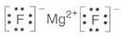
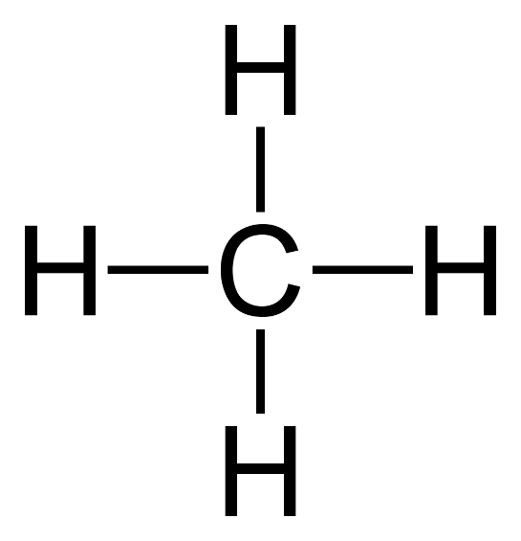
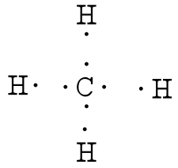
Lewis Symbols compounds
main group
OCTET RULE: atoms in main group compounds tend to lose, gain, or share e- until they are surrounded by
8 valence e- (Corresponds to full s + p subshells like a noble gas → 2s + 6p = 8 valence e-)
Write the Lewis symbol for magnesium fluoride.
Ionic compounds →atoms lose or gain e- until each has an octet (elements in the compound have a large difference in electronegativity, more than ~2.0)
Write the Lewis symbol for methane, CH₄.
Covalent compounds → atoms share e- pairs in covalent bonds until each has an octet (except H, which only needs a duet, or 2 e-)
(elements in the compound have a small difference in electronegativity; less than a difference of ~2.0)
Represent bonding pairs as a line ( – )
Notes:
Atoms in compounds (really main group compounds and is most accurate for organic compounds) tend to…
Write the Lewis symbol for magnesium fluoride.
First, is this an ionic compound or a covalently bonded compound? Does it involve 2 nonmetals (covalent bonds), 2 metals (metallic bonds), or 1 metal + 1 nonmetal (ionic bonds?
Write the Lewis symbol for methane, CH₄.
Is this an ionic compound or a covalently bonded compound?

Slide 8


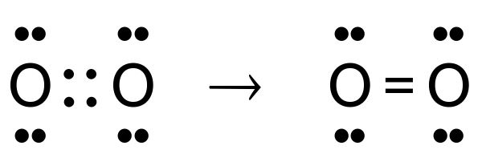

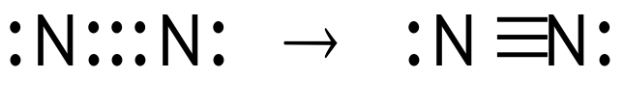
Lewis Symbols:
Bonding Pairs vs. lone pairs
Single Bond:
    One pair of e- shared by two atoms
    Represented as a single line (–)
    Example: HCl
Double Bond:
  Two pairs of e- shared by two atoms
  Represented as a double line ( = )
  Example: O₂ →
Triple Bond:
  Three pairs of e- shared by two atoms
  Represented as triple line ( ≡ )
  Example: N₂ →
Note how many bonds each atom formed…
BONDING PAIRS: pairs of e- shared in a bond
LONE PAIRS: pairs of e- not shared in a bond (left alone on their original atom)
Notes:
Given a chemical formula, we can use this rule to predict which atoms are bonded & how many e- they share

Slide 9
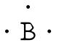
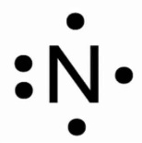

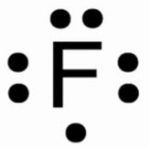
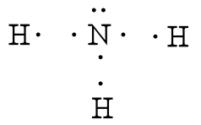
Lewis Symbols:
Predicting Bond #’s
The # of unpaired dots in an element’s Lewis symbol (for main group nonmetals) predicts the typical # of covalent bonds that element forms (especially in period 2)
We can use this to predict which atoms are bonded in covalent compounds & how many e- they share!
1 bond
3 bonds
4 bonds
3 bonds
2 bonds
1 bond
Let’s practice:
Draw the Lewis structure for ammonia, NH₃
There is a systematic way to apply these ideas…
Notes:
Given a chemical formula, we can use this rule to predict which atoms are bonded & how many e- they share

Slide 10


Lewis recipe
Example: HCN
Count the total valence e- present
Predict the connectivity of the atoms
  Central atom = atom that can form the most bonds and/or
  is the least electronegative atom
  Order of atoms in formula is often indicative
  Often use the most symmetric structure possible
Draw single bonds to connect all atoms
Use remaining e- as lone pairs to complete octets of all atoms (most electronegative atoms first)
  If there are not enough e- to go around, convert some lone pairs to bonding pairs
  If there are more e- than needed, put remaining e- on the central atom as lone pairs
    (if the central atom is from period 3 or higher)
Check that the # of e- in your Lewis structure matches the # in step 1
Check that the # of bonds makes sense
  Ensure each atom type forms its typical # of bonds
  AND/OR: apply the following formula:
  Count the total e- needed for each atom to have its own octet
    Each atom needs 8 for an octet (H needs 2)
  Find the difference (needed – present)
  Divide by two. This is the total number of bonds to make
OCTET RULE: atoms tend to gain, lose, or share e- until they are surrounded by 8 valence e-
Notes:
Yep, that’s my mom! Mrs. Lewis!
0:15

Slide 11
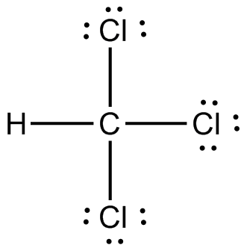

Practice Drawing Lewis Structures
Draw Lewis diagrams of these molecules (covalent compounds):
  CHCl₃
  CH₂O
Count the valence e- present
Predict the connectivity of the atoms
  Central atom = atom that can form the most bonds and/or is the least electronegative atom
Draw single bonds to connect all atoms
Use remaining e- as lone pairs to complete octets of all atoms (give e- to most electronegative atoms first)
  If there are not enough e- to go around, convert some lone pairs to bonding pairs
  If there are more e- than needed, put remaining e- on the central atom as lone pairs (if the central atom is from period 3 or higher)
Check that the # of e- in your structure matches the # in step 1
Check the # of bonds (total + individual)
Notes:
Finish by 0:25-0:28

Slide 12

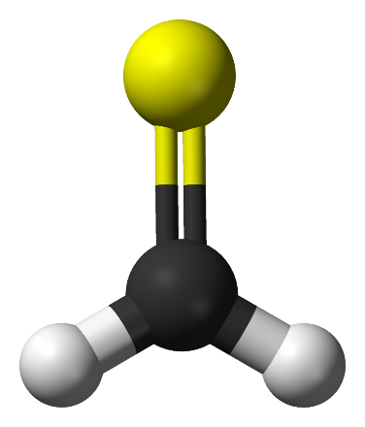
iClicker Quiz
Draw a Lewis structure for thioformaldehyde, CH₂S.
How many single and double bonds does C have?
3 single bonds, 0 double bonds
2 single bonds, 1 double bond
1 single bond, 2 double bonds
0 single bonds, 3 double bonds
None of the above
Notes:
Finish by 0:25

Slide 13
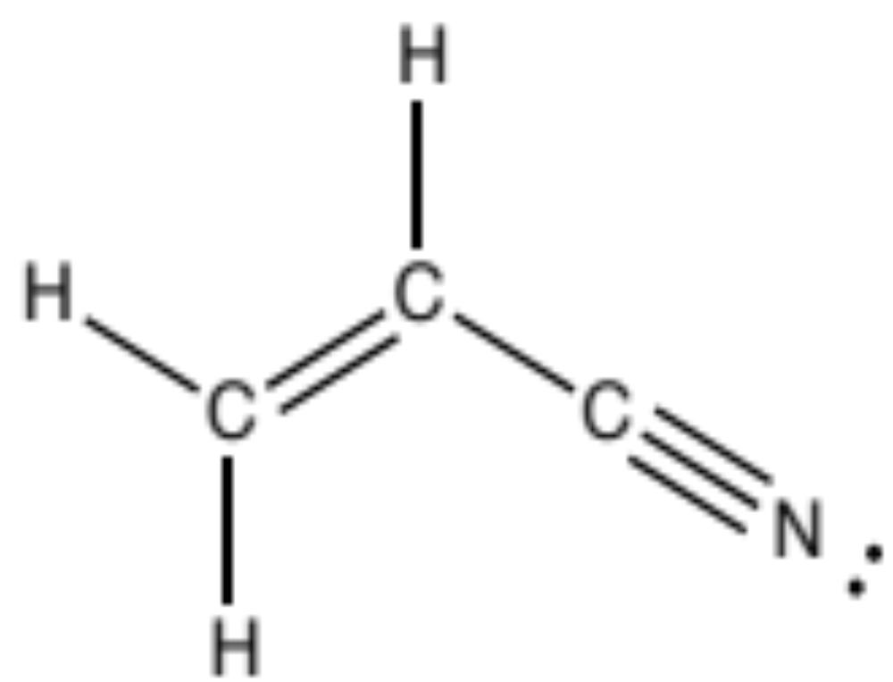
Bond Order
# of bonds between a pair of atoms
2
1
Double bond
Single bond
Lone Pair
Double and even triple bonds are commonly observed for C, N, P, O, and S
3
Triple bond
Acrylonitrile
Notes:
Homopolymers of polyacrylonitrile have been used as fibers in hot gas filtration systems, outdoor awnings, sails for yachts, and fiber-reinforced concrete. Copolymers containing polyacrylonitrile are often used as fibers to make knitted clothing like socks and sweaters, as well as outdoor products like tents and similar items. If the label of a piece of clothing says "acrylic", then it is made out of some copolymer of polyacrylonitrile. It was made into spun fiber at DuPont in 1942 and marketed under the name of Orlon. Acrylonitrile is commonly employed as a comonomer with styrene, e.g. acrylonitrile, styrene and acrylate plastics.
Acrylonitrile is highly flammable and toxic. It undergoes explosive polymerization. The burning material releases fumes of hydrogen cyanide and oxides of nitrogen. It is classified as a Class 2B carcinogen (possibly carcinogenic) by the International Agency for Research on Cancer (IARC),[7] and workers exposed to high levels of airborne acrylonitrile are diagnosed more frequently with lung cancer than the rest of the population.[8] It evaporates quickly at room temperature (20 °C) to reach dangerous concentrations; skin irritation, respiratory irritation, and eye irritation are the immediate effects of this exposur

Slide 14
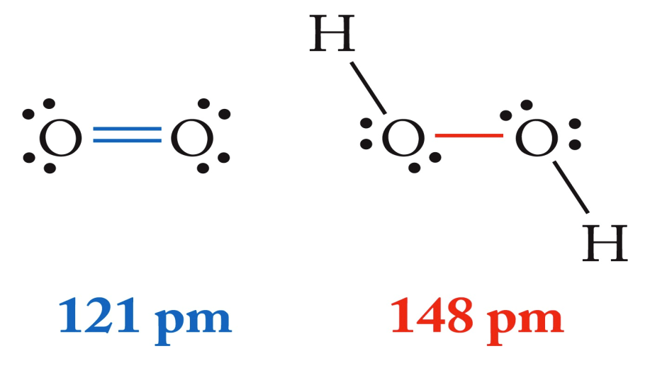
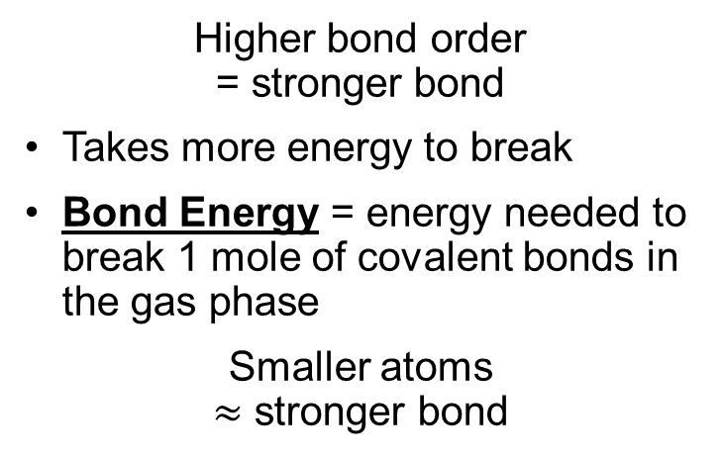
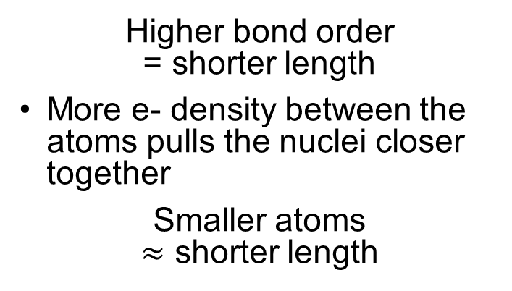
Bond Length & Strength
Depend On
(1) Bond order
(2) Size of the atoms
498 kJ/mol
146 kJ/mol
Bond Strength
Bond Length
Higher bond order
= stronger bond
Takes more energy to break
Bond Energy = energy needed to break 1 mole of covalent bonds in the gas phase
Smaller atoms
$≈$ stronger bond
Higher bond order
= shorter length
More e- density between the atoms pulls the nuclei closer together
Smaller atoms
$≈$ shorter length

Slide 15
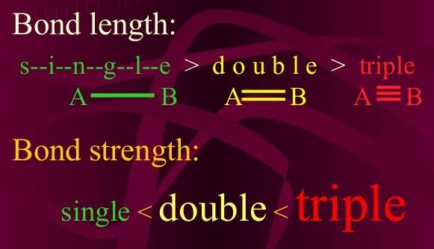
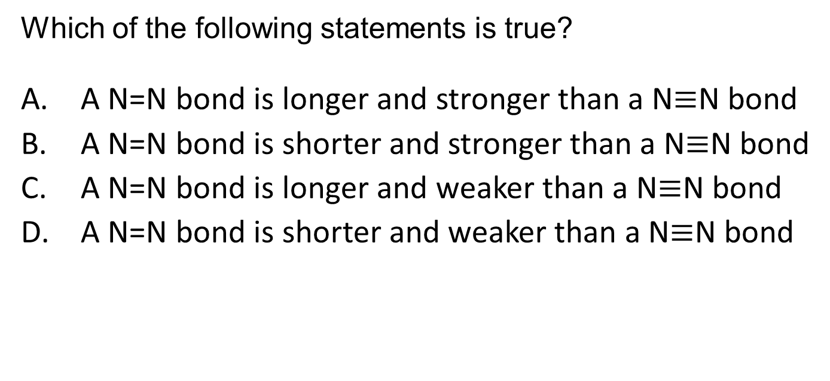
iClicker Quiz
Which of the following statements is true?
A N=N bond is longer and stronger than a N$≡$N bond
A N=N bond is shorter and stronger than a N$≡$N bond
A N=N bond is longer and weaker than a N$≡$N bond
A N=N bond is shorter and weaker than a N$≡$N bond
Bond length is inversely proportional to bond strength
Notes:
C
3Mg²⁺ + 2P^{3–} ⟶ Mg₃P₂

Slide 16
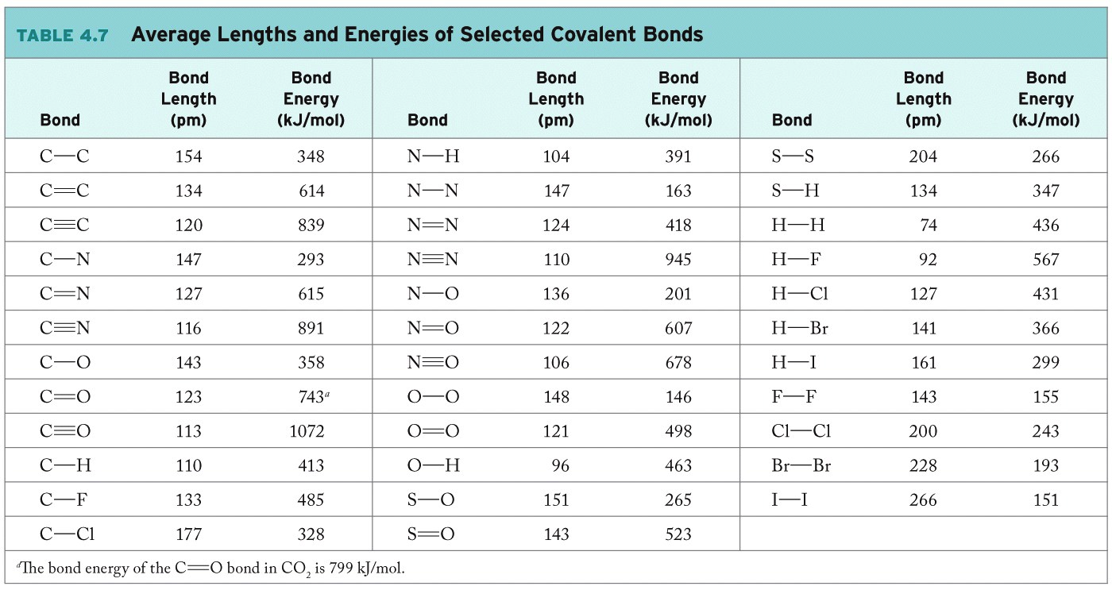
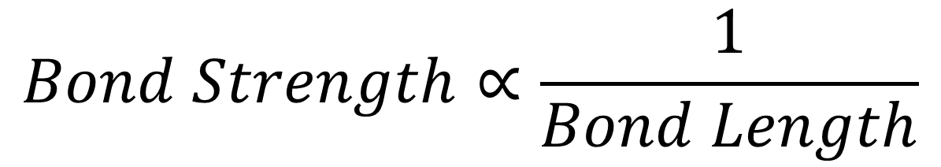
$$Bond Strength∝\frac{1}{Bond Length}$$
Notes:
Bond length is inversely proportional to bond strength
Highest bond energy = shortest bond distance
Smallest bond energy = longest bond distance

Slide 17
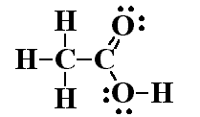
Practice Drawing Lewis Structures
Draw Lewis diagrams of these molecules (covalent compounds):
  CHCl₃
  CH₂O
  acetic acid, CH₃COOH
Count the valence e- present
Predict the connectivity of the atoms
  Central atom = atom that can form the most bonds and/or is the least electronegative atom
Draw single bonds to connect all atoms
Use remaining e- as lone pairs to complete octets of all atoms (give e- to most electronegative atoms first)
  If there are not enough e- to go around, convert some lone pairs to bonding pairs
  If there are more e- than needed, put remaining e- on the central atom as lone pairs (if the central atom is from period 3 or higher)
Check that the # of e- in your structure matches the # in step 1
Check the # of bonds (total + individual)
Notes:
Finish by 0:35

Slide 18
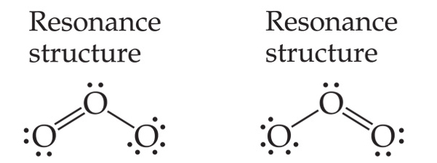
Resonance
Draw the Lewis structure for ozone, O₃
2 possible Lewis structures for O₃!
Which one do you draw?
Both of them!
When more than 1 arrangement of ELECTRONS (with the same atom configuration) is plausible, we draw all plausible “resonance structures” with a double-sided arrow between them
  Follow normal rules for drawing Lewis structures
  Keep atoms in each resonance structure in the same place—
  rearrange electrons, NOT ATOMS
  Make sure each resonance structure has the same net charge
NOTE: resonance structures are NOT real
The actual molecule is a weighted average of all the resonance structures and is more stable than any of the individual fictional resonance structures (though we still call it “resonance stabilized”)
What IS real?

Slide 19
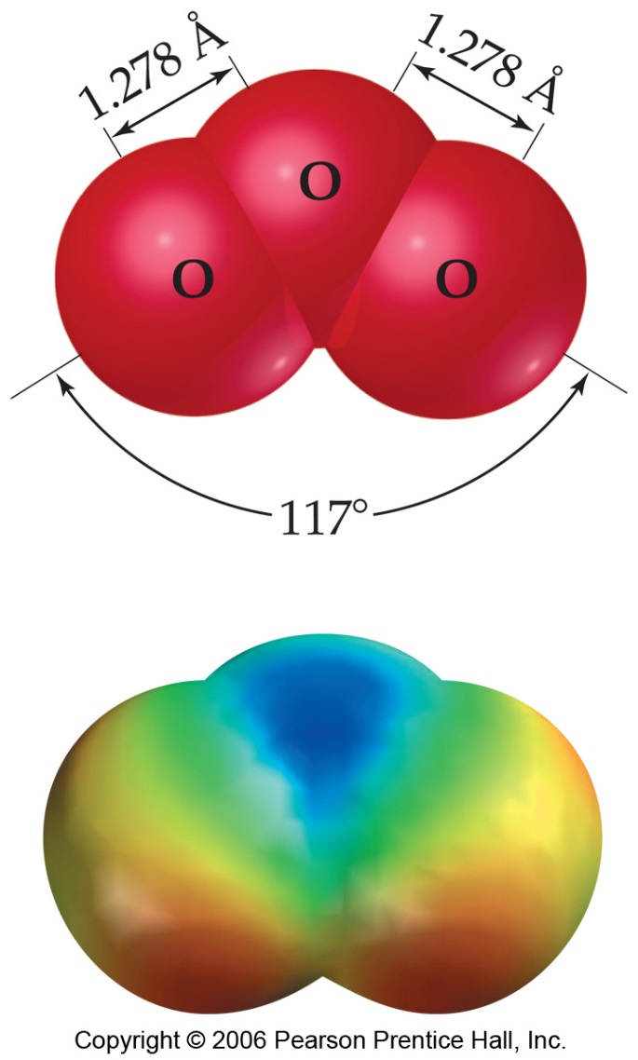

Delocalization:
Spreading e- over more than 1 bond
The e- in ozone are “delocalized” across both bonds
The observed structure of ozone has 2 equivalent O-O bonds:
    same length
    identical bond order between 1-2
    charge of –½ on both outer O atoms
Ozone does NOT have 1 single and 1 double bond rapidly switching back and forth

Slide 20
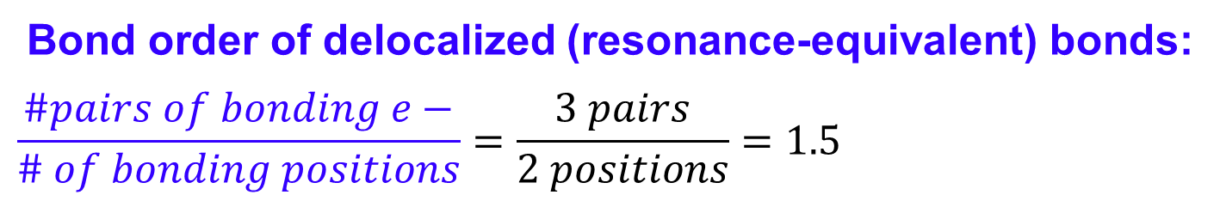
Resonance
& Bond order
So what is the bond order in ozone?
Bond order of delocalized (resonance-equivalent) bonds:
$$\frac{\#pairs of bonding e−}{\# of bonding positions}=\frac{3 pairs}{2 positions}=1.5$$
Why draw resonance structures if they’re not real?
Electron bookkeeping! It’s much easier to keep track of electrons & determine bond order from resonance structures than from delocalized structures

Slide 21
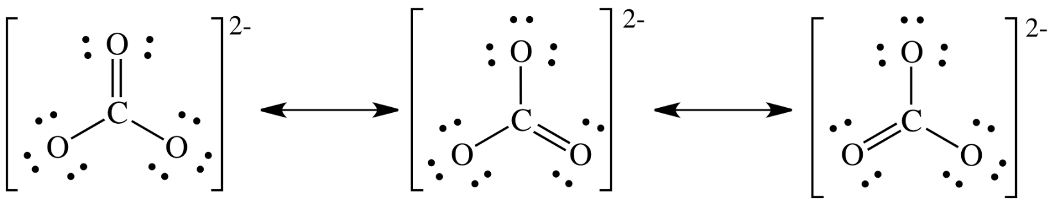
Why draw resonance structures
For example: Draw the Lewis structure for carbonate (CO₃^{2–}).
Include all equivalent resonance structures
Notes:
Example CO2

Slide 22
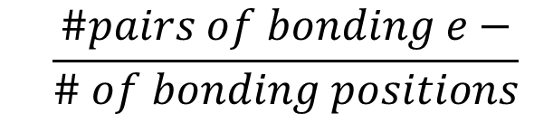
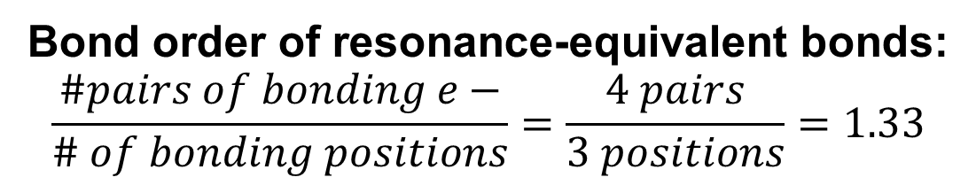
iClicker Quiz
What is the C-O bond order in carbonate, CO₃²⁻?
1
1.33
1.5
1.67
2 single, 1 double bond
Bond order of resonance-equivalent bonds:
$$\frac{\#pairs of bonding e−}{\# of bonding positions}=\frac{4 pairs}{3 positions}=1.33$$
But resonance structures don’t always contribute equally to the delocalization…

